Slide 1
Chapter 11
Compiler II: Code Generation

Slide 2
Usage Notice
You are welcome to use this presentation, or any part of it, in Nand to Tetris courses, or in other courses, as you see fit.
Usage is free for instruction in educational, non-profit settings.
For permission to use the materials in other settings, contact schocken@gmail.com
You can use the slides as-is, or modify them as needed.
We’ll appreciate it if you will credit Nand to Tetris somewhere, and put a reference to www.nand2tetris.org
To stay in touch with our course team about updates and new teaching materials, fill in this form.
Happy teaching!
Shimon Schocken / Noam Nisan

Slide 3
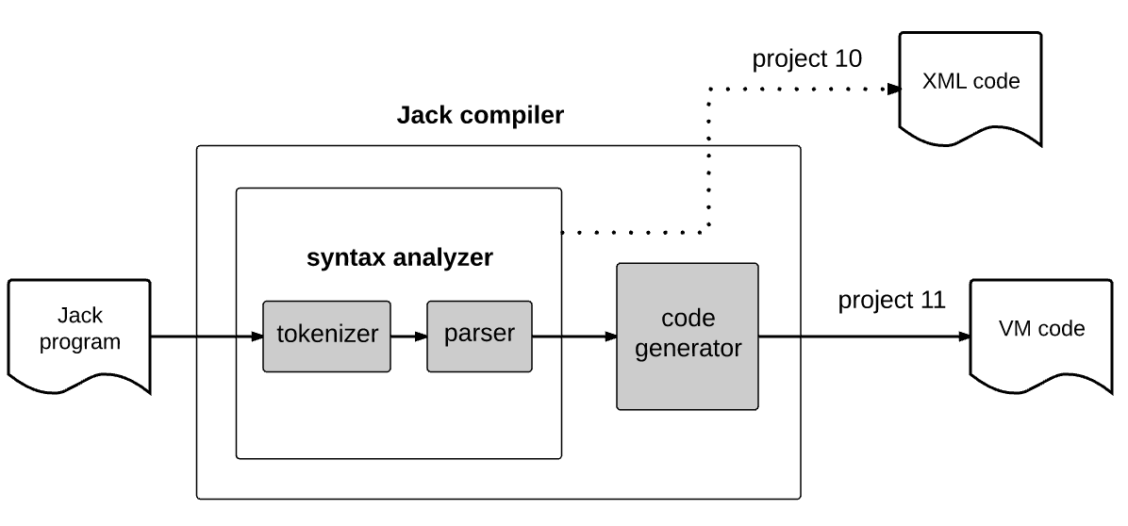
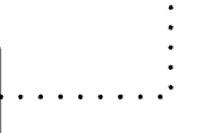
Compiler development roadmap

Slide 4
Compiler development roadmap

Slide 5

Compiler development roadmap

Slide 6
Compiler development roadmap
project 11
This lecture:
Extending the syntax analyzer to a full-scale compiler.

Slide 7
Take home lessons
Implementing a procedural programming language
Variables
Expressions
Statements
Flow of control
Arrays
Functions
Implementing an object-based programming language
Objects
Constructors
Methods
Software engineering
Parsing (mostly done)
Symbol tables
Compilation engine
Code generation
Memory management.

Slide 8
Program compilation
High-level source code (Jack)
class Point {
field int x, y;
static int pointCount;
constructor Point new(int ax, int ay) {}
method int getx() {}
method int gety() {}
function int getPointCount() {}
method Point plus(Point other) {}
method int distance(Point other) {
var int dx, dy;
let dx = x - other.getx();
let dy = y - other.gety();
return Math.sqrt((dx*dx) + (dy*dy));
}
...
}
Class declarations:
fields
statics
Subroutine declarations:
constructors
methods
functions

Slide 9
Program compilation
High-level source code (Jack)
class Point {
field int x, y;
static int pointCount;
constructor Point new(int ax, int ay) {}
method int getx() {}
method int gety() {}
function int getPointCount() {}
method Point plus(Point other) {}
method int distance(Point other) {
var int dx, dy;
let dx = x - other.getx();
let dy = y - other.gety();
return Math.sqrt((dx*dx) + (dy*dy));
}
...
}
Compilation challenges
Handling variables
Handling expressions
Handling statements
Handling objects
Handling arrays

Slide 10
Variables
Source code
class Point {
field int x, y;
static int pointCount;
...
method int distance(Point other) {
var int dx, dy;
let dx = x - other.getx();
let dy = y - other.gety();
return Math.sqrt((dx*dx) + (dy*dy));
}
...
}

Slide 11
Variables
Source code
VM code (generated by the compiler)
class Point {
field int x, y;
static int pointCount;
...
method int distance(Point other) {
var int dx, dy;
let dx = x - other.getx();
let dy = y - other.gety();
return Math.sqrt((dx*dx) + (dy*dy));
}
...
}
compiler

Slide 12
Variables
Source code
VM code (generated by the compiler)
class Point {
field int x, y;
static int pointCount;
...
method int distance(Point other) {
var int dx, dy;
let dx = x - other.getx();
let dy = y - other.gety();
return Math.sqrt((dx*dx) + (dy*dy));
}
...
}
...
// return Math.sqrt((dx*dx) + (dy*dy));
push local 0
push local 0
call Math.multiply 2
push local 1
push local 1
call Math.multiply 2
add
call Math.sqrt 1
return
...
compiler
In order to generate VM code, the compiler must know, for each variable in the program:
Variable properties
name (identifier)
type (int, char, boolean, class name)
kind (field, static, local, argument)
index (0, 1, 2, ...)
scope (class level, subroutine level)

Slide 13
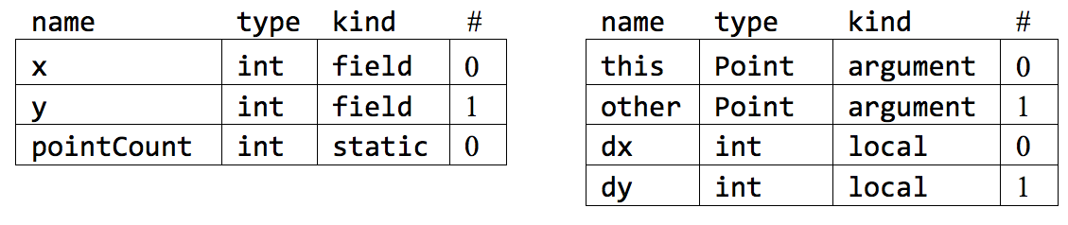
Symbol tables
Source code
class Point {
field int x, y;
static int pointCount;
...
method int distance(Point other) {
var int dx, dy;
let dx = x - other.getx();
let dy = y - other.gety();
return Math.sqrt((dx*dx) + (dy*dy));
}
...
}
class-level symbol table
subroutine-level symbol table
We’ll discuss the variable this (argument 0) later in the lecture
Variable properties
name (identifier)
type (int, char, boolean, class name)
kind (field, static, local, argument)
index (0, 1, 2, ...)
scope (class level, subroutine level)
(4,6)
5

Slide 14
Handling variable declarations
Source code
class Point {
field int x, y;
static int pointCount;
...
method int distance(Point other) {
var int dx, dy;
let dx = x - other.getx();
let dy = y - other.gety();
return Math.sqrt((dx*dx) + (dy*dy));
}
...
}
class-level symbol table
subroutine-level symbol table
Variable declarations occur in class declarations, in method declarations (parameter lists), and in var statements.
The compiler handles each…
field variable declaration by adding a field i entry to the class-level symbol table
static variable declaration by adding a static i entry to the class-level symbol table
parameter variable declaration by adding an argument i entry to the subroutine-level symbol table
var variable declaration by adding a local i entry to the subroutine-level symbol table.

Slide 15
Handling variable usage
Source code
class Point {
field int x, y;
static int pointCount;
...
method int distance(Point other) {
var int dx, dy;
let dx = x - other.getx();
let dy = y - other.gety();
return Math.sqrt((dx*dx) + (dy*dy));
}
...
}
class-level symbol table
subroutine-level symbol table
Variables are used in statements and in expressions
The compiler looks up the variable name in the subroutine-level symbol table. If not found, it looks it up in the class-level symbol table.
Each field, static, local, parameter variable name in the source code is translated into this i, static i, local i, argument i, in the generated VM code.
source code
VM code
compiler
push this 0
push local 0
add
pop this 0
let x = x + dx
(example)

Slide 16
Handling variables life cycle
Source code
class Point {
field int x, y;
static int pointCount;
...
method int distance(Point other) {
var int dx, dy;
let dx = x - other.getx();
let dy = y - other.gety();
return Math.sqrt((dx*dx) + (dy*dy));
}
...
}
Static variables: Exist throughout the program’s execution
Local variables: Each time a subroutine starts running during runtime, it gets a fresh set of local variables; each time a subroutine returns, its local variables are recycled
Argument variables: Same as local variables
Field variables: Unique to object-oriented languages; will be discussed later.
Managing these variables life cycles is a major headache
But… this is taken care of by the VM implementation (projects 7 – 8)
The compiler need not worry about it!

Slide 17
Handling nested scoping
class foo {
// class-level variable declarations
method bar () {
// method-level variable declarations
...
{
// scope-1-level variable declarations
...
{
// scope-2-level variable declarations
...
Some high-level languages (but not Jack) feature unlimited nested variable scoping
Nested scoping can be handled using a linked list of symbol tables:
scope 2 level
scope 1 level
method level
class level
symbol tables
. . .
symbol table
symbol table
symbol table
symbol table
Variable lookup: Start in the first table in the list: if not found, look up the next table, and so on.

Slide 18
Lecture plan
Compilation
Handling variables
Handling expressions
Handling statements
Handling objects
Handling arrays

Slide 19
Expressions
x + y – 2

Slide 20
Expressions
–
+
2
x
y
Prefix notation
Infix notation
Postfix notation
– + x y 2
x + y – 2
x y + 2 –
(functional)
(human friendly)
(stack oriented)
– (+ ( x , y ), 2 )

Slide 21
Compiling expressions
Parse Tree
VM code
–
push x
push y
add
push 2
sub
Source code
parse
generate
x + y – 2
+
2
Infix notation, human-friendly
x
y
When executed during runtime, the generated code ends up leaving the value of the expression at the top of the stack
Postfix notation, stack oriented
Option 1: Parse the infix source expression into a parse tree, then generate the postfix VM code from the tree
Option 2: Generate the VM code directly from the source expression.

Slide 22
Compiling expressions
Recursive algorithm for generating postfix VM code from an expression written in infix notation:
compileExpression(exp):
if exp is term:
compileTerm(term)
if exp is "term₁ op₁ term₂ op₂
term₃ op₃ … term_{n} ":
compileTerm(term₁)
compileTerm(term₂)
output "op₁"
compileTerm(term₃)
output "op₂"
...
compileTerm(term_{n})
output "op_{n–1}"
compileTerm(term):
if term is a constant c:
output "push c"
if term is a variable var:
output "push var"
if term is "unaryOp term":
compileTerm(term)
output "unaryOp"
if term is "(exp)":
compileExpression(exp)
if term is "f (exp₁, exp₂, ...)":
compileExpression(exp₁)
compileExpression(exp₂)
...
compileExpression(exp_{n})
output "call f "
The formal definition of term was given in chapter 10
The syntactic handling of terms in expressions was done by the Syntax Analyzer (project 10).

Slide 23
Compiling expressions
Compilation examples
(assuming that x and y are
local 0 and local 1)
Recursive algorithm for generating postfix VM code from an expression written in infix notation:
compileExpression(exp):
if exp is term:
compileTerm(term)
if exp is "term₁ op₁ term₂ op₂
term₃ op₃ … term_{n} ":
compileTerm(term₁)
compileTerm(term₂)
output "op₁"
compileTerm(term₃)
output "op₂"
...
compileTerm(term_{n})
output "op_{n–1}"
compileTerm(term):
if term is a constant c:
output "push c"
if term is a variable var:
output "push var"
if term is "unaryOp term":
compileTerm(term)
output "unaryOp"
if term is "(exp)":
compileExpression(exp)
if term is "f (exp₁, exp₂, ...)":
compileExpression(exp₁)
compileExpression(exp₂)
...
compileExpression(exp_{n})
output "call f n"
// 5 + x
push constant 5
push local 0
add
// x + y – 2
push local 0
push local 1
add
push constant 2
sub
// foo(x, y + 1,–7)
push local 0
push local 1
push constant 1
add
push constant 7
neg
call foo 3
Note: This algorithm…
Does not handle array elements (later)
Supports no operator priority.

Slide 24
Compiling expressions
The Jack language specifies no operator priority
(In purpose, to make the compiler simpler)
The default priority is left-to-right:
push constant 5
push constant 3
add
push constant 2
call Math.multiply 2
5 + 3 * 2
compiler
But, expressions in parentheses are evaluated first:
compiler
push constant 5
push constant 3
push constant 2
call Math.multiply 2
add
5 + (3 * 2)
Indeed, the compileExpression algorithm evaluates expressions in parentheses first.

Slide 25
Compiling expressions
Handling the four constants of the Jack language
true is represented as –1
false is represented as 0
null is represented as 0
this is represented as pointer 0
Compilation examples (in the context of return statements)
// return true;
push constant 1
neg
return
// return false;
push constant 0
return
// return null;
push constant 0
return
// return this;
push pointer 0
return

Slide 26
Lecture plan
Compilation
Handling variables
Handling expressions
Handling statements
Handling objects
Handling arrays

Slide 27
Lecture plan
Compilation
Handling variables
Handling expressions
Handling statements
let
return
do
if
while
Handling objects
Handling arrays
Handled by five compilation routines: compileLet, compileReturn, compileDo, compileIf, compileWhile

Slide 28
Compiling let
source code (Jack)
VM code (generated by compileLet)
...
let varName = expression;
...
...
VM code generated by compileExpression
pop varName
...
compiler
To handle a let statement, compileLet calls compileExpression to translate the statement’s right hand side. When the compiled VM code will execute during runtime, it will end up leaving the expression’s value at the stack’s top. The subsequent pop command will then assign it to varName.

Slide 29
Compiling let
source code (Jack)
VM code (generated by compileLet)
...
let varName = expression;
...
...
VM code generated by compileExpression
pop varName
...
compiler
To handle a let statement, compileLet calls compileExpression to translate the statement’s right hand side. When the compiled VM code will execute during runtime, it will end up leaving the expression’s value at the stack’s top. The subsequent pop command will then assign it to varName.
Example:
let v = g + r2;
compiler
// v = g + r2;
push static 0
push this 1
add
pop local 1
The blue code is generated by compileExpression
name | type | kind | #
g | int | static | 0
r1 | int | field | 0
r2 | int | field | 1
class-level
symbol table
name | type | kind | #
u | int | local | 0
v | int | local | 1
subroutine-level symbol table

Slide 30
Lecture plan
Compilation
Handling variables
Handling expressions
Handling statements
let
return
do
if
while
Handling objects
Handling arrays

Slide 31
Compiling return
source code
VM code (generated by compileReturn)
...
return expression;
...
...
VM code generated by compileExpression
return
...
compiler
compileLet calls compileExpression. During runtime, the code generated by compileExpression will end up leaving the expression’s value at the stack’s top. The VM implementation of the subsequent return command will place this value at the top of the caller’s stack, when the caller resumes its execution.
(The return statement has two versions)
...
return;
...
...
push constant 0
return
...
compiler
A VM function must return a value. When compiling a return statement without a return value, the compiler generates code that pushes a dummy value onto the stack
This value will be tossed away by the compiled code of the caller (discussed next).

Slide 32
Lecture plan
Compilation
Handling variables
Handling expressions
Handling statements
let
return
do
if
while
Handling objects
Handling arrays

Slide 33
Compiling do
source code (Jack)
VM code (generated by compileDo)
...
do subroutineName(exp1, exp2, …)
...
compiler
...
VM code generated by compileExpression
pop temp 0
...
The do statement is used to call a function or a method for its effect, ignoring the returned value
We recommend handling do subroutineName(…) statements as if they where do expression statements.
The subsequent pop gets rid of the return value.
Example:
compiler
// do Output.printInt(7);
push constant 7
call Output.printInt 1
pop temp 0
do Output.printInt(7);
Blue code: Generated by compileExpression
Observation: The compilation of do statements is trivial. Just remember to get rid of the return value.

Slide 34
Lecture plan
Compilation
Handling variables
Handling expressions
Handling statements
let
return
do
if
while
Handling objects
Handling arrays

Slide 35
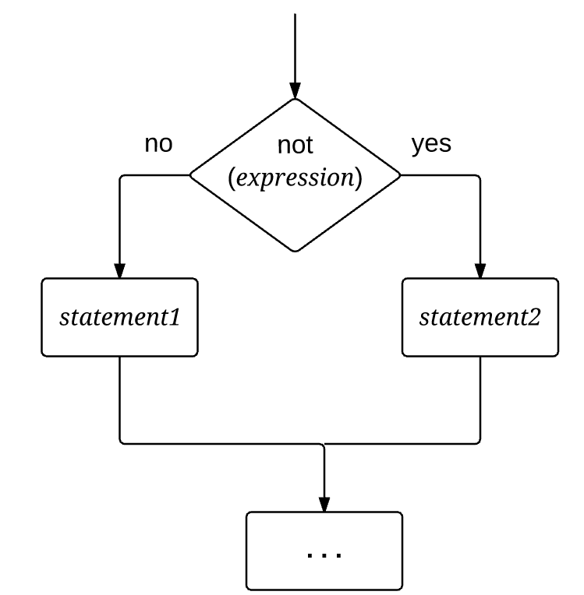
Compiling if
source code
VM code (generated by compileIf)
if ( expression )
{ statements1 }
else
{ statements2 }
...
VM code generated by compileExpression
not
if-goto L1
VM code generated by compileStatements
goto L2
label L1
VM code generated by compileStatements
label L2
...
compiler
(the labels L1 and L2 are generated by the compiler)

Slide 36
Compiling if
source code
VM code (generated by compileIf)
if ( expression )
{ statements1 }
else
{ statements2 }
...
VM code generated by compileExpression
not
if-goto L1
VM code generated by compileStatements
goto L2
label L1
VM code generated by compileStatements
label L2
...
compiler
(the labels L1 and L2 are generated by the compiler)
Example:
if (u > 0) {
let v = g;
}
...
// if (u > 0) { let v = g }
push u
push 0
gt
not
if-goto L1
push g
pop v
label L1
...
compiler

Slide 37
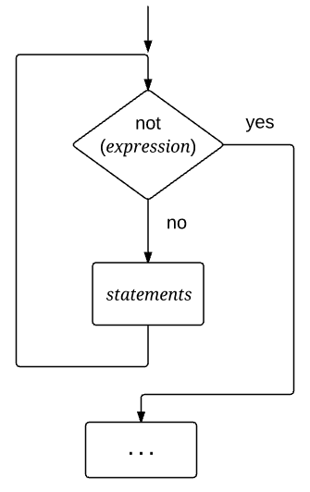
Compiling while
source code
VM code (generated by compileWhile)
while ( expression )
{ statements }
...
label L1
VM code generated by compileExpression
not
if-goto L2
VM code generated by compileStatements
goto L1
label L2
...
compiler
(the labels L1 and L2 are generated by the compiler)

Slide 38
Compiling while
source code
VM code (generated by compileWhile)
while ( expression )
{ statements }
...
label L1
VM code generated by compileExpression
not
if-goto L2
VM code generated by compileStatements
goto L1
label L2
...
compiler
Example:
(the labels L1 and L2 are generated by the compiler)
while (g = 0) {
let x = x + 1;
}
...
// while (g = 0) { let x = x + 1 }
label L1
push g
push 0
eq
not
if-goto L2
push x
push 1
add
pop x
goto L1
label L2
...
compiler

Slide 39
Lecture plan
Compilation
Handling variables
Handling expressions
Handling statements
Handling objects
Handling arrays
We have what it takes to write a compiler for a procedural programming language!

Slide 40
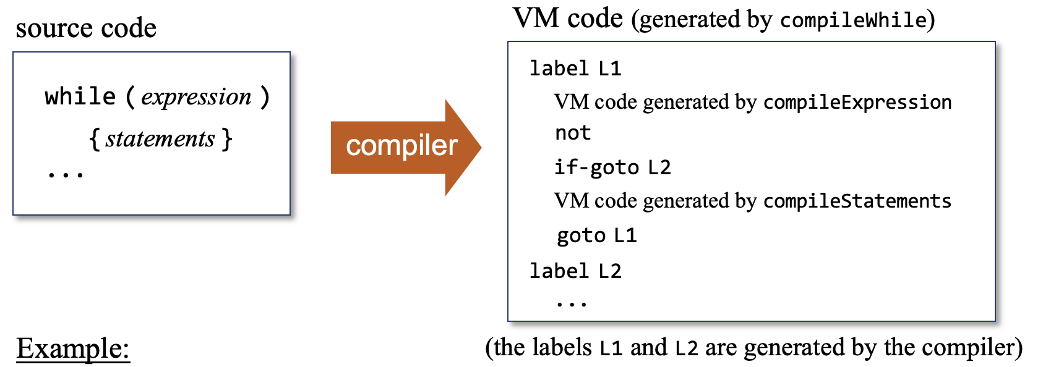
Before proceeding, a side note
Our goal: Teaching compilation fundamentals
We don’t want to rob from you the pleasure of writing a compiler on your own;
We describe the major building blocks of a simple compiler, and expect you to figure out how to put them together. For example, consider our explanation on how to handle while:
In project 11, you will write the compileWhile rouitine that realizes this translation
Your compileWhile code will have to generates unique labels like L1 and L2 (possibly using other names). It will have to remember where in the output to emit which label. It will have to call compileExpression, and then emit to the output the not and the if-goto L2 commands, and then call compileStatements, and so on.
Of course you will also have to write the compileExpression and compileStatements routines, following similar explanations.
Back to the lecture…

Slide 41
Lecture plan
Compilation
Handling variables
Handling expressions
Handling statements
Handling objects
Handling arrays
We have what it takes to write a compiler for a procedural programming language!

Slide 42
Memory management primer
Host RAM
0
SP
1
LCL
system pointers
2
ARG
3
THIS
4
THAT
...
Stores objects and arrays data
Heap:
...

Slide 43
Memory management primer
Exercise: Create, and initialize, a 2-words object:
Host RAM
// Creates a 2-words object, and aligns the virtual
// segment this with its base address:
push constant 2
call Memory.alloc 1
pop pointer 0
0
SP
1
LCL
system pointers
2
ARG
3
6012
THIS
4
THAT
...
...
6012
5
Stores objects and arrays data
To “create a new object”: We need to allocate memory. This can be done by calling an OS function named Memory.alloc
Like all the OS functions, Memory.alloc is implemented, and is accessible as, a compiled VM function.
7
Heap:
(address 6012 is an arbitrary example)
...
Memory.alloc(n):
Finds a free memory block of size n words,
and returns the base address of the found block.
Memory.alloc uses clever memory management algorithms, learned and implemented in chapter 12

Slide 44
Memory management primer
Exercise: Create, and initialize, a 2-words object:
Host RAM
// Creates a 2-words object, and aligns the virtual
// segment this with its base address:
push constant 2
call Memory.alloc 1
pop pointer 0
// Initializes the object’s fields to 5 and 7:
push constant 5
pop this 0
push constant 7
pop this 1
0
SP
1
LCL
system pointers
2
ARG
3
6012
THIS
4
THAT
...
...
6012
5
Stores objects and arrays data
pop pointer 0:
(Reminder: pointer 0 and pointer 1 represent THIS and THAT).
In the above context, this command sets THIS to the base address of the newly constructed object.
This setting ensures that the this segment will be properly aligned with the object’s base address in memory.
And this, in turn, ensures that in the subsequent VM-to-assembly translation, every this i reference in the VM code will be mapped correctly on the memory addresses (THIS + i).
7
Heap:
(address 6012 is an arbitrary example)
...
Using this technique, we can apply a method’s code to any object; All we need is its base address.
Perhaps the most important “enabling trick” in object-oriented programming.

Slide 45
Creating objects
Source code
// Can appear in any class:
...
// Declares three local variables:
var Point p1, p2;
var int d;
...
// Constructs two objects:
let p1 = Point.new(2,3);
let p2 = Point.new(5,7);
...
Object creation
is typically a 2-stage process:
Declaring an object variable,
Creating the object and assigning it to the variable
caller
Caller: Creates two Point objects, and makes p1 and p2 refer to them
Callee: Creates a Point object, and returns its base memory address
Typically involves:
Caller
Callee (constructor)
/** Represents a Point (API). */
class Point {
...
/** Constructs a point. */
constructor Point new(int ax, int ay)
// ... More Point methods follow
}
callee
Abstraction
(“objects”)

Slide 46
Creating objects
Source code
Host RAM
// Can appear in any class:
...
// Declares three local variables:
var Point p1, p2;
var int d;
...
// Constructs two objects:
let p1 = Point.new(2,3);
let p2 = Point.new(5,7);
...
0
SP
caller
1
LCL
2
ARG
Caller: Creates two Point objects, and makes p1 and p2 refer to them
3
THIS
4
THAT
...
...
stack
9543
local 0 (p1)
6012
local 1 (p2)
Callee: Creates a Point object, and returns its base memory address
0
local 2 (d)
/** Represents a Point (API). */
class Point {
...
/** Constructs a point. */
constructor Point new(int ax, int ay)
// ... More Point methods follow
}
...
...
6012
5
(addresses 6012 and 9543 are arbitrarily-chosen examples)
heap
7
...
...
9543
2
callee
3
...
...
Abstraction
(“objects”)
Realization
(managed memory blocks)
Who realizes the object creation abstraction?
The code that the compiler generates from the caller and the callee.

Slide 47
Compiling constructor calls
Source code
VM code
Host RAM
// Can appear in any class:
...
// Declares three local variables:
var Point p1, p2;
var int d;
...
// Constructs two objects:
let p1 = Point.new(2,3);
let p2 = Point.new(5,7);
...
0
SP
caller
1
LCL
2
ARG
3
THIS
4
THAT
...
...
compile
stack
9543
local 0 (p1)
6012
local 1 (p2)
0
local 2 (d)
...
...
6012
5
(addresses 6012 and 9543 are arbitrarily-chosen examples)
heap
7
...
...
9543
2
3
...
...

Slide 48
Compiling constructor calls
Source code
VM code
Host RAM
// Can appear in any class:
...
// Declares three local variables:
var Point p1, p2;
var int d;
...
// Constructs two objects:
let p1 = Point.new(2,3);
let p2 = Point.new(5,7);
...
// var Point p1, p2;
// var int d;
//// The compiler builds the
//// method’s symbol table.
...
0
SP
caller
1
LCL
2
ARG
3
THIS
4
THAT
...
...
compile
stack
9543
local 0 (p1)
6012
local 1 (p2)
0
local 2 (d)
...
name | type | kind | #
p1 | Point | local | 0
p2 | Point | local | 1
d | int | local | 2
...
6012
5
(addresses 6012 and 9543 are arbitrarily-chosen examples)
heap
7
...
...
9543
2
3
...
...

Slide 49
Compiling constructor calls
Source code
VM code
Host RAM
// Can appear in any class:
...
// Declares three local variables:
var Point p1, p2;
var int d;
...
// Constructs two objects:
let p1 = Point.new(2,3);
let p2 = Point.new(5,7);
...
// var Point p1, p2;
// var int d;
//// The compiler builds the
//// method’s symbol table.
...
// let p1 = Point.new(2,3);
push constant 2
push constant 3
call Point.new 2
pop local 0
// let p2 = Point.new(5,7);
push constant 5
push constant 7
call Point.new 2
pop local 1
...
0
SP
caller
1
LCL
2
ARG
3
THIS
4
THAT
...
...
compile
stack
9543
local 0 (p1)
6012
local 1 (p2)
0
local 2 (d)
...
name | type | kind | #
p1 | Point | local | 0
p2 | Point | local | 1
d | int | local | 2
...
6012
5
(addresses 6012 and 9543 are arbitrarily-chosen examples)
heap
7
...
...
9543
2
The source code calls a constructor, which is a subroutine, for its effect.
The caller’s expectations from the constructor: Create, initialize, and return (the base address of) a new object.
If we trust this expected behavior abstractly, there’s nothing special here;
The compiler simply calls the compileLet routine, which generates the VM code.
3
...
...
The heavy lifting will be done by the compiled constructor code (next).

Slide 50
Compiling constructors
High-level code
// Can appear in any class:
var Point p1;
...
let p1 = Point.new(2,3);
...
caller
/** Represents a Point. */
class Point {
field int x, y;
static int pointCount;
...
/** Constructs a new point. */
constructor Point new(int ax, int ay) {
let x = ax;
let y = ay;
let pointCount = pointCount + 1;
return this;
}
...
Expected to create a Point object, initialize its fields, and return its base memory address.
callee

Slide 51
Compiling constructors
High-level code
// Can appear in any class:
var Point p1;
...
let p1 = Point.new(2,3);
...
caller
VM code
/** Represents a Point. */
class Point {
field int x, y;
static int pointCount;
...
/** Constructs a new point. */
constructor Point new(int ax, int ay) {
let x = ax;
let y = ay;
let pointCount = pointCount + 1;
return this;
}
...
compile
callee

Slide 52
Compiling constructors
High-level code
// Can appear in any class:
var Point p1;
...
let p1 = Point.new(2,3);
...
caller
VM code
/** Represents a Point. */
class Point {
field int x, y;
static int pointCount;
...
/** Constructs a new point. */
constructor Point new(int ax, int ay) {
let x = ax;
let y = ay;
let pointCount = pointCount + 1;
return this;
}
...
// class Point {
// field int x, y;
// static int pointCount;
//// the compiler builds the class-level symbol table.
compile
callee
name | type | kind | #
x | int | field | 0
y | int | field | 1
pointCount | int | static | 0
class-level
symbol table

Slide 53
Compiling constructors
High-level code
// Can appear in any class:
var Point p1;
...
let p1 = Point.new(2,3);
...
caller
VM code
/** Represents a Point. */
class Point {
field int x, y;
static int pointCount;
...
/** Constructs a new point. */
constructor Point new(int ax, int ay) {
let x = ax;
let y = ay;
let pointCount = pointCount + 1;
return this;
}
...
// class Point {
// field int x, y;
// static int pointCount;
//// the compiler builds the class-level symbol table.
// constructor Point new(int ax, int ay);
//// The compiler builds the constructor’s symbol table,
//// adds ax and ay to it, and handles all the var statements,
//// of which there are none in this constructor.
compile
callee
name | type | kind | #
x | int | field | 0
y | int | field | 1
pointCount | int | static | 0
class-level
symbol table

Slide 54
Compiling constructors
High-level code
// Can appear in any class:
var Point p1;
...
let p1 = Point.new(2,3);
...
caller
VM code
/** Represents a Point. */
class Point {
field int x, y;
static int pointCount;
...
/** Constructs a new point. */
constructor Point new(int ax, int ay) {
let x = ax;
let y = ay;
let pointCount = pointCount + 1;
return this;
}
...
// class Point {
// field int x, y;
// static int pointCount;
//// the compiler builds the class-level symbol table.
// constructor Point new(int ax, int ay);
//// The compiler builds the constructor’s symbol table,
//// adds ax and ay to it, and handles all the var statements,
//// of which there are none in this constructor.
//// Next, the compiler generates the commands:
function Point.new 0
push constant 2
call Memory.alloc 1
pop pointer 0
//// Next, the compiler handles the constructor’s body.
//// Note: The compilation of return this generates
//// the commands push pointer 0 and return.
compile
callee
name | type | kind | #
x | int | field | 0
y | int | field | 1
pointCount | int | static | 0
class-level
symbol table
name | type | kind | #
ax | int | arg | 0
ay | int | arg | 1
When executed, the generated constructor’s code will construct an object of the right size, align this with the new object’s base address, and return the base address to the caller.
constructor-level symbol table

Slide 55
Compiling constructors
High-level code
When the caller resumes its execution, p1 will be assigned the base address of the new object.
// Can appear in any class:
var Point p1;
...
let p1 = Point.new(2,3);
...
caller
VM code
/** Represents a Point. */
class Point {
field int x, y;
static int pointCount;
...
/** Constructs a new point. */
constructor Point new(int ax, int ay) {
let x = ax;
let y = ay;
let pointCount = pointCount + 1;
return this;
}
...
// class Point {
// field int x, y;
// static int pointCount;
//// the compiler builds the class-level symbol table.
// constructor Point new(int ax, int ay);
//// The compiler builds the constructor’s symbol table,
//// adds ax and ay to it, and handles all the var statements,
//// of which there are none in this constructor.
//// Next, the compiler generates the commands:
function Point.new 0
push constant 2
call Memory.alloc 1
pop pointer 0
//// Next, the compiler handles the constructor’s body.
//// Note: The compilation of return this generates
//// the commands push pointer 0 and return.
compile
callee
name | type | kind | #
x | int | field | 0
y | int | field | 1
pointCount | int | static | 0
class-level
symbol table
name | type | kind | #
ax | int | arg | 0
ay | int | arg | 1
When executed, the generated constructor’s code will construct an object of the right size, align this with the new object’s base address, and return the base address to the caller.
constructor-level symbol table

Slide 56
Lecture plan
Compilation
Handling variables
Handling expressions
Handling statements
Handling objects
Creating objects
Manipulating objects
Handling arrays

Slide 57
Method calling primer
high-level code
let d = p1.distance(p2)
The caller “applies a method on an object”
caller
How to pass the target object from the caller to the callee?
class Point
...
/** Distance from this to the other point. */
method int distance(Point other) {
...
}
...
}
callee
The called(method) responds by “operating on the given object”
Designed to operate on any object of the class type

Slide 58
Method calling primer
high-level code
VM (pseudo) code
let d = p1.distance(p2)
compiler
...
push p1
push p2
call distance
pop d
...
caller
Compilation conventions:
1. When compiling a method call, we always pass the target object as the first argument for the called method
class Point
...
/** Distance from this to the other point. */
method int distance(Point other) {
...
}
...
}
...
function distance
push argument 0
pop pointer 0
...
callee
compiler
This is the key compilation trick
that enables the OO “object first” method calling syntax:
objName.methodName(args)
2. When compiling a method, we always start with ”this = argument 0”. This ensures that all the subsequent “this i” references will map on the fields of the target object.

Slide 59
Method calling primer
And now for the details…

Slide 60
Compiling methods calls / Compiling methods
...
let d = p1.distance(p2);
...
Method call abstraction:
Host RAM
Applies the method distance to the object p1
0
SP
caller
1
LCL
2
ARG
/** Represents a Point. */
class Point {
field int x, y;
static int pointCount;
...
/** Distance from this to the other point */
method int distance(Point other) {
var int dx, dy;
let dx = x – other.getx();
let dy = y – other.gety();
return Math.sqrt((dx*dx) + (dy*dy));
}
...
}
3
THIS
Method abstraction:
4
THAT
...
Applies the method to the current object (this)
...
stack
9543
local 0 (p1)
6012
local 1 (p2)
0
local 2 (d)
...
...
6012
5
(addresses 6012 and 9543 are arbitrarily-chosen examples)
heap
7
...
...
callee
9543
2
3
...
...
Who realizes the method calling abstraction?
The code that the compiler generates from the caller and the callee.

Slide 61
Compiling methods calls / Compiling methods
...
let d = p1.distance(p2);
...
caller
/** Represents a Point. */
class Point {
field int x, y;
static int pointCount;
...
/** Distance from this to the other point */
method int distance(Point other) {
var int dx, dy;
let dx = x – other.getx();
let dy = y – other.gety();
return Math.sqrt((dx*dx) + (dy*dy));
}
...
}
callee

Slide 62
Compiling methods calls / Compiling methods
...
let d = p1.distance(p2);
...
compiler
VM code
name | type | kind | #
p1 | Point | local | 0
p2 | Point | local | 1
d | int | local | 2
...
push local 0
push local 1
call Point.distance 2
pop local 2
...
caller
/** Represents a Point. */
class Point {
field int x, y;
static int pointCount;
...
/** Distance from this to the other point */
method int distance(Point other) {
var int dx, dy;
let dx = x – other.getx();
let dy = y – other.gety();
return Math.sqrt((dx*dx) + (dy*dy));
}
...
}
callee

Slide 63
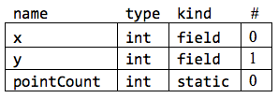
Compiling methods calls / Compiling methods
...
let d = p1.distance(p2);
...
compiler
VM code
name | type | kind | #
p1 | Point | local | 0
p2 | Point | local | 1
d | int | local | 2
...
push local 0
push local 1
call Point.distance 2
pop local 2
...
caller
/** Represents a Point. */
class Point {
field int x, y;
static int pointCount;
...
/** Distance from this to the other point */
method int distance(Point other) {
var int dx, dy;
let dx = x – other.getx();
let dy = y – other.gety();
return Math.sqrt((dx*dx) + (dy*dy));
}
...
}
VM code
// class Point {
// field int x, y;
// static int pointCount;
//// compileClass builds the class-level symbol table,
//// and adds to it the variables x, y, and pointCount.
compiler
callee
class-level
symbol table

Slide 64
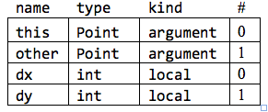
Compiling methods calls / Compiling methods
...
let d = p1.distance(p2);
...
compiler
VM code
name | type | kind | #
p1 | Point | local | 0
p2 | Point | local | 1
d | int | local | 2
...
push local 0
push local 1
call Point.distance 2
pop local 2
...
caller
/** Represents a Point. */
class Point {
field int x, y;
static int pointCount;
...
/** Distance from this to the other point */
method int distance(Point other) {
var int dx, dy;
let dx = x – other.getx();
let dy = y – other.gety();
return Math.sqrt((dx*dx) + (dy*dy));
}
...
}
VM code
// class Point {
// field int x, y;
// static int pointCount;
//// compileClass builds the class-level symbol table,
//// and adds to it the variables x, y, and pointCount.
// method int distance(Point other)
// var int dx, dy;
//// compileSubroutine builds the method’s symbol
//// table, and adds to it the variables this, other, dx, dy.
//// Next, it generates the code:
function Point.distance 2
push argument 0
pop pointer 0
compiler
callee
class-level
symbol table
method-level symbol table

Slide 65
Compiling methods calls / Compiling methods
...
let d = p1.distance(p2);
...
compiler
VM code
name | type | kind | #
p1 | Point | local | 0
p2 | Point | local | 1
d | int | local | 2
...
push local 0
push local 1
call Point.distance 2
pop local 2
...
caller
/** Represents a Point. */
class Point {
field int x, y;
static int pointCount;
...
/** Distance from this to the other point */
method int distance(Point other) {
var int dx, dy;
let dx = x – other.getx();
let dy = y – other.gety();
return Math.sqrt((dx*dx) + (dy*dy));
}
...
}
VM code
// class Point {
// field int x, y;
// static int pointCount;
//// compileClass builds the class-level symbol table,
//// and adds to it the variables x, y, and pointCount.
// method int distance(Point other)
// var int dx, dy;
//// compileSubroutine builds the method’s symbol
//// table, and adds to it the variables this, other, dx, dy.
//// Next, it generates the code:
function Point.distance 2
push argument 0
pop pointer 0
//// Next, compileStatements is called to handle the method’s
//// statements.
compiler
callee
class-level
symbol table
method-level symbol table

Slide 66
Compiling methods calls / Compiling methods
...
let d = p1.distance(p2);
...
compiler
VM code
name | type | kind | #
p1 | Point | local | 0
p2 | Point | local | 1
d | int | local | 2
...
push local 0
push local 1
call Point.distance 2
pop local 2
...
caller
/** Represents a Point. */
class Point {
field int x, y;
static int pointCount;
...
/** Distance from this to the other point */
method int distance(Point other) {
var int dx, dy;
let dx = x – other.getx();
let dy = y – other.gety();
return Math.sqrt((dx*dx) + (dy*dy));
}
...
}
VM code
// method int distance(Point other) {
// var int dx, dy;
function Point.distance 2
push argument 0
pop pointer 0
// let dx = x – other.getx();
push this 0
push argument 1
call Point.getx 1
sub
pop local 0
// let dy = y – other.gety();
//// Similar, code omitted.
// return Math.sqrt((dx*dx)+(dy*dy));
push local 0
push local 0
call Math.multiply 2
push local 1
push local 1
call Math.multiply 2
add
call Math.sqrt 1
return
compiler
callee
class-level
symbol table
method-level symbol table

Slide 67
Lecture plan
Compilation
Handling variables
Handling expressions
Handling statements
Handling objects
Handling arrays

Slide 68
Lecture plan
Compilation
Handling variables
Handling expressions
Handling statements
Handling objects
Handling arrays
Creating arrays
Manipulating array elements

Slide 69
Lecture plan
Compilation
Handling variables
Handling expressions
Handling statements
Handling objects
Handling arrays
Creating arrays
Manipulating array elements

Slide 70
Creating arrays
Source code
Host RAM
// Can appear in any class:
...
// Declares an array variable:
var Array arr;
...
// Constructs the array:
let arr = Array.new(5);
...
// Manipulates the array
let arr[2] = 17;
...
0
SP
1
LCL
2
ARG
3
THIS
4
THAT
...
...
stack
...
...
heap
In the Jack language, arrays are implemented as instances of an OS class named Array
Arrays are constructed by calling Array.new
Array.new will be implemented in chapter 12, when we’ll build the OS.
...
...

Slide 71
Creating arrays
Source code
VM code
Host RAM
// Can appear in any class:
...
// Declares an array variable:
var Array arr;
...
// Constructs the array:
let arr = Array.new(5);
...
// Manipulates the array
let arr[2] = 17;
...
0
SP
1
LCL
2
ARG
3
THIS
4
THAT
...
...
compile
stack
...
...
heap
In the Jack language, arrays are implemented as instances of an OS class named Array
Arrays are constructed by calling Array.new
Array.new will be implemented in chapter 12, when we’ll build the OS.
...
...

Slide 72
Creating arrays
Source code
VM code
Host RAM
// Can appear in any class:
...
// Declares an array variable:
var Array arr;
...
// Constructs the array:
let arr = Array.new(5);
...
// Manipulates the array
let arr[2] = 17;
...
...
// var Array arr;
//// The compiler builds the
//// method’s symbol table.
...
0
SP
1
LCL
2
ARG
3
THIS
4
THAT
...
...
stack
local 0 (arr)
compile
...
...
name | type | kind | #
arr | Array | local | 0
heap
In the Jack language, arrays are implemented as instances of an OS class named Array
Arrays are constructed by calling Array.new
Array.new will be implemented in chapter 12, when we’ll build the OS.
...
...

Slide 73
Creating arrays
Source code
VM code
Host RAM
// Can appear in any class:
...
// Declares an array variable:
var Array arr;
...
// Constructs the array:
let arr = Array.new(5);
...
// Manipulates the array
let arr[2] = 17;
...
...
// var Array arr;
//// The compiler builds the
//// method’s symbol table.
...
0
SP
1
LCL
2
ARG
3
THIS
4
THAT
...
...
stack
local 0 (arr)
compile
...
...
name | type | kind | #
arr | Array | local | 0
heap
The source code calls Array.new, which is a subroutine, for its effect.
The caller’s expectations: Create, initialize, and return (the base address of) a new array.
If we trust this expected behavior abstractly, there’s nothing special here;
The compiler simply calls the compileLet routine, which generates the VM code.
...
...

Slide 74
Creating arrays
Source code
VM code
Host RAM
// Can appear in any class:
...
// Declares an array variable:
var Array arr;
...
// Constructs the array:
let arr = Array.new(5);
...
// Manipulates the array
let arr[2] = 17;
...
...
// var Array arr;
//// The compiler builds the
//// method’s symbol table.
...
// let arr = Array.new(5);
push constant 5
call Array.new 1
pop local 0
...
0
SP
1
LCL
2
ARG
3
THIS
4
THAT
...
...
stack
8054
local 0 (arr)
compile
...
...
8054
(address 8054 is an arbitrarily-chosen example)
name | type | kind | #
arr | Array | local | 0
heap
8055
8056
8057
8058
The source code calls Array.new, which is a subroutine, for its effect.
The caller’s expectations: Create, initialize, and return (the base address of) a new array.
If we trust this expected behavior abstractly, there’s nothing special here;
The compiler simply calls the compileLet routine, which generates the VM code.
...
...

Slide 75
Lecture plan
Compilation
Handling variables
Handling expressions
Handling statements
Handling objects
Handling arrays
Creating arrays
Manipulating array elements

Slide 76
Manipulating array elements
Example:
Host RAM
// let arr[2] = 17
0
SP
1
LCL
2
ARG
3
THIS
4
8056
THAT
...
...
stack
8054
local 0 (arr)
...
...
Reminder (VM implementation):
pointer 0 represents THIS
pointer 1 represents THAT
Suppose we set pointer 1 = addr
In the subsequent VM-to-Assembly translation, every occurrence of that i in the VM code will be translated into the machine-level address addr + i
In particular, that 0 will map on address addr.
8054
(address 8054 is an arbitrarily-chosen example)
heap
8055
8056
17
8057
8058
...
...

Slide 77
Manipulating array elements
Example:
Host RAM
// let arr[2] = 17
push arr
push 2
add
pop pointer 1 // THAT = arr + 2
push 17
pop that 0
0
SP
1
LCL
2
ARG
3
THIS
4
8056
THAT
...
...
stack
8054
local 0 (arr)
...
...
Reminder (VM implementation):
pointer 0 represents THIS
pointer 1 represents THAT
Suppose we set pointer 1 = addr
In the subsequent VM-to-Assembly translation, every that i in the VM code will map on the machine-level address addr + i
In particular, that 0 will map on address addr.
8054
(address 8054 is an arbitrarily-chosen example)
heap
8055
8056
17
8057
8058
...
...

Slide 78
Manipulating array elements
Example:
Host RAM
// let arr[2] = 17
push arr
push 2
add
pop pointer 1 // THAT = arr + 2
push 17
pop that 0
0
SP
1
LCL
2
ARG
3
THIS
4
8056
THAT
...
...
stack
8054
local 0 (arr)
...
...
Generalizing into a compilation strategy (first try…):
8054
(address 8054 is an arbitrarily-chosen example)
heap
8055
8056
17
// let arr[expression₁] = expression₂
push arr
push expression₁
add
pop pointer 1
push expression₂
pop that 0
8057
8058
...
...
Note:
“push expression” is pseudo code for
//// call compileExpression (which computes,
//// and pushes the value of, expression)

Slide 79

Manipulating array elements
Host RAM
0
SP
unfortunately, there’s a problem
1
LCL
2
ARG
3
THIS
4
8056
THAT
...
...
stack
8054
local 0 (arr)
...
...
8054
(address 8054 is an arbitrarily-chosen example)
General compilation strategy (first try…)
heap
8055
8056
17
// let arr[expression₁] = expression₂
push arr
push expression₁
add
pop pointer 1
push expression₂
pop that 0
8057
8058
...
...
Note:
“push expression” is pseudo code for
//// call compileExpression (which computes,
//// and pushes the value of, expression)

Slide 80
Manipulating array elements
The problem, illustrated
// let a[i] = b[j]

Slide 81
Manipulating array elements
The problem, illustrated
// let a[i] = b[j]
push a
push i
add
pop pointer 1

Slide 82

Manipulating array elements
The problem, illustrated
Solution
// let a[i] = b[j]
push a
push i
add
pop pointer 1
// Now handle the right hand side
push b
push j
add
pop pointer 1
// let a[i] = b[j]
push a
push i
add
push b
push j
add
pop pointer 1
push that 0
pop temp 0
pop pointer 1
push temp 0
pop that 0
At this point, during runtime:
The stack topmost value is the address of a[i]
temp 0 contains the value of b[j]
crash!

Slide 83
Manipulating array elements
Solution (general)
// let arr[expression₁] = expression₂
push arr
//// call compileExpression to compute and push expression₁
add // top stack value = address of arr[expression₁]
//// call compileExpression to compute and push expression₂
pop temp 0 // temp 0 = the value of expression₂
pop pointer 1
push temp 0
pop that 0
What about handling, say, let a[a[i]] = a[b[a[b[j]]]] ?
No problem... Thx to the stack’s LIFO behavior.

Slide 84
Lecture plan
Compilation
Handling variables
Handling expressions
Handling statements
Handling objects
Handling arrays
Implementation
Standard mapping
Proposed design
Project 11

Slide 85
Standard mapping
So far we described:
General compilation techniques
Compiling Jack code
We now turn to describe:
How to generate code for the the specific VM language and OS of the Hack computer
(There will be some repetition of things already described).

Slide 86



The big picture
points folder
points folder
points.asm
points.hack
Main.jack
Main.vm
...
M=D
@i
M=0
(LOOP)
@i
D=M
@n
D=D-M
@END
D;JGT
@addr
...
...
1101010010101011
1100001101010101
0101010011101100
1100101111111111
0101110101010011
1100111111010101
0101110110101011
1100100000001011
0101110111100010
1111000111010100
0010101000101011
0111000111010111
1010101000101011
...
class Main
function void main {
var Point p1;
...
}
}
...
push local 1
push const 3
add
...
JackCompiler
VM translator
assembler
Point.jack
Point.vm
class Point
field int x,y;
...
}
...
push arg 2
call Math.sqrt
...
load
(4,6)
5
A Jack program / app is a collection of one or more class files, in same folder (here, named points)
Each class file ClassName.jack is compiled separately into the file ClassName.vm

Slide 87
Subroutines (implementation notes)
Foo.jack
Foo.vm
class Foo {
constructor Foo new(int x) {}
method void bar(int x) {}
function int baz(int x) {}
}
function Foo.new
...
function Foo.bar
...
function Foo.baz
...
JackCompiler
A Jack class is a collection of one or more subroutines
Each subroutine (constructor, function, method) subName in a file ClassName.jack is compiled into a VM function named ClassName.subName

Slide 88
Constants (implementation notes)
The Jack language has four constants
true is represented in VM code as constant 1, followed by neg
false is represented in VM code as constant 0
null is represented in VM code as constant 0
this is represented in VM code as pointer 0

Slide 89
Variables (implementation notes)
Local variables
Are mapped on local 0, local 1, local 2, …
Argument variables
Are mapped on argument 0, argument 1, argument 2, …
Static variables
Are mapped on static 0, static 1, static 2, …
Field variables
Are mapped on this 0, this 1, this 2, …

Slide 90
Arrays (implementation notes)
Access to array element arr[i]
Is implemented by generating VM code that realizes:
set pointer 1 to arr + i
push / pop that 0
Implementation tip: There is never a need use that i for i greater than 0.

Slide 91
Subroutine calls (implementation notes)
(Suppose that we are compiling the file ClassName.jack )
Compiling a constructor or a function call subName(exp₁, exp₂, ..., exp_{n})
The generated VM code pushes the expressions exp₁, exp₂, ..., exp_{n} onto the stack, followed by the command call ClassName.subName n
Compiling a method call obj.subName(exp₁, exp₂, ..., exp_{n})
The generated VM code pushes obj and then exp₁, exp₂, ..., exp_{n} onto the stack, followed by the command call ClassName.subName n + 1
If the called subroutine is void:
Just after the call, the generated VM code call gets rid of the return value using the command pop temp 0

Slide 92
Subroutines (implementation notes)
When compiling a Jack method:
The first entry in the method’s symbol table must be a variable named this whose type is the name of the class to which the method belongs, kind is argument, and index is 0
The generated VM code starts by setting pointer 0 (this) to argument 0
When compiling a Jack constructor:
The generated VM code starts by:
Calling the OS function Memory.alloc n, where n is the number of fields in the class
Setting pointer 0 (this) to alloc’s return value
The generated VM code ends with return pointer 0
When compiling a void function or a void method:
The generated VM code ends with push constant 0 and then return

Slide 93
The OS (implementation notes)
The OS is written in Jack (chapter 12)
The OS is implemented as a set of 8 compiled Jack classes:
Math.vm
Memory.vm
Screen.vm
Output.vm
Keyboard.vm
String.vm
Array.vm
Sys.vm
Every OS subroutine ClassName.subName is available as a compiled VM function, and can be called by the generated VM code using the usual call command call ClassName.subName nArgs
Available in
nand2tetris/tools/os
Usage
If you wish to translate the generated VM code to assembly, put the eight OS *.vm ﬁles in the same folder as the VM ﬁles generated by the compiler, and apply the translator to the folder.
If you execute / test the generated VM code on the supplied VM emulator (recommended in this project), then there is no need to either translate or include any OS files: The supplied VM emulator features a built-in implementation of all the OS subroutines.

Slide 94
The OS (implementation notes)
The generated VM code handles…
Multiplication ( * ) by calling the OS function Math.multiply()
Division ( / ) by calling the OS function Math.divide()
String constants by calling the OS constructor String.new(length)
String assignments like x = "cc ... c" by making a sequence of calls to String.appendChar(c)
Object construction by calling the OS function Memory.alloc(size)

Slide 95
Lecture plan
Compilation
Handling variables
Handling expressions
Handling statements
Handling objects
Handling arrays
Implementation
Standard mapping
Proposed design
Project 11

Slide 96
The Jack compiler
project 10
project 10
project 11
Project 11: Morphing the syntax analyzer into a full scale compiler, using the modules:
JackCompiler: top-most (“main”) module
JackTokenizer
CompilationEngine
SymbolTable
VMWriter

Slide 97
The Jack compiler
Usage:
prompt> JackCompiler input
Input:
fileName.jack: name of a single source file, or
folderName: name of a folder containing one or more .jack source files
Output:
if the input is a single file: fileName.vm
if the input is a folder: one .vm file for every .jack file, stored in the same folder

Slide 98
The Jack compiler
JackCompiler
JackTokenizer
CompilationEngine
SymbolTable
VMWriter
For each source .jack file, the compiler creates a JackTokenizer and an output .vm file
Next, the compiler uses the CompilationEngine to write the VM code into the output .vm file.

Slide 99
JackTokenizer
The JackTokenizer handles the compiler’s input.
Provides services for:
Ignoring white space
Getting the current token and advancing the input just beyond it
Getting the type of the current token
(Developed in project 10)

Slide 100
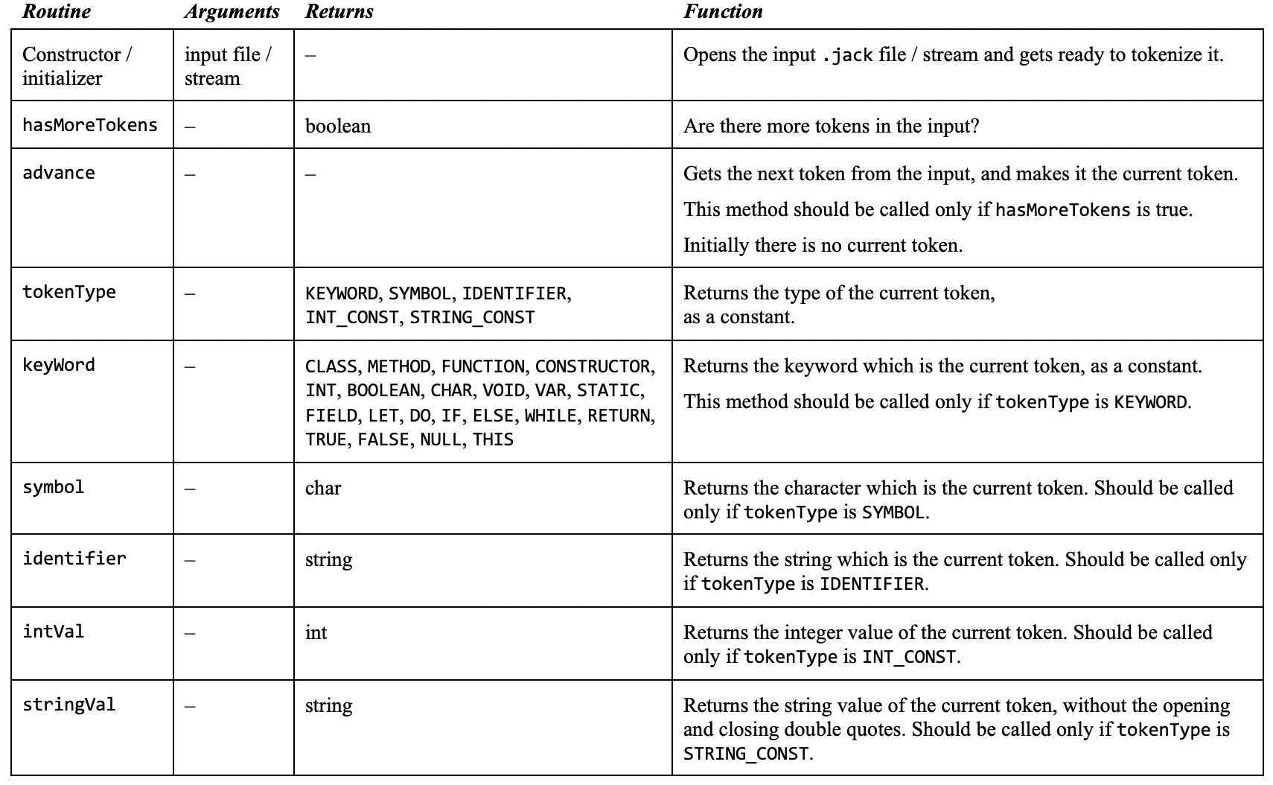
JackTokenizer (same as in project 10)
JackTokeinizer: Ignores all comments and white space, gets the next token, and advances the input just beyond it

Slide 101
The Jack compiler
JackCompiler
JackTokenizer
CompilationEngine
SymbolTable
VMWriter

Slide 102
SymbolTable
Jack source code
class Point {
field int x, y;
static int pointCount;
...
method int distance(Point other) {
var int dx, dy;
let dx = x - other.getx();
let dy = y - other.gety();
return Math.sqrt((dx*dx)+ (dy*dy));
}
...
}
class-level symbol table
subroutine-level symbol table

Slide 103
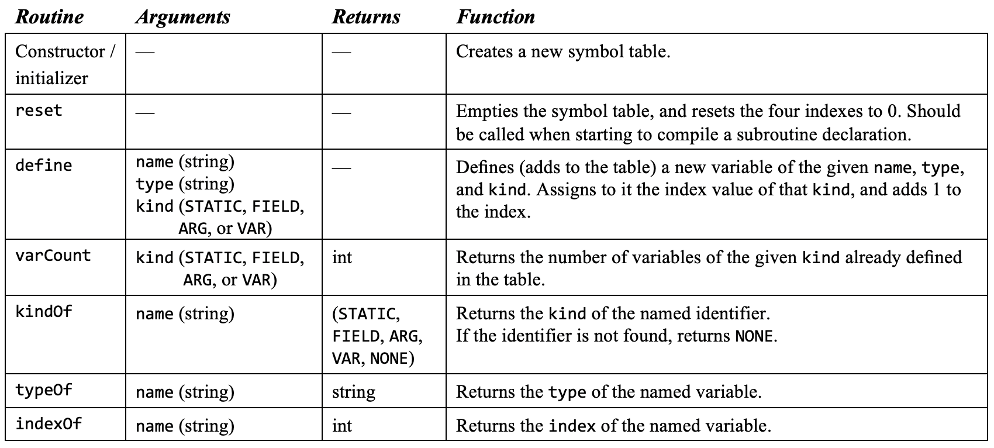
SymbolTable
Implementation notes:
Each symbol table can be implemented as a separate instance of SymbolTable
When compiling a Jack class, we can build one class-level symbol table and one subroutine-level symbol table
We can reset the latter table each time we start compiling a new subroutine
class-level symbol table
subroutine-level symbol table
SymbolTable API

Slide 104
SymbolTable
Implementation notes:
Each variable is assigned a running index within its scope (table) and kind. The index starts at 0, increments by 1 after each time a new symbol is added to the table, and is reset to 0 when starting a new scope (table)
When compiling an error-free Jack code, each symbol not found in the symbol tables can be assumed to be either a subroutine name or a class name.
class-level symbol table
subroutine-level symbol table
SymbolTable API

Slide 105
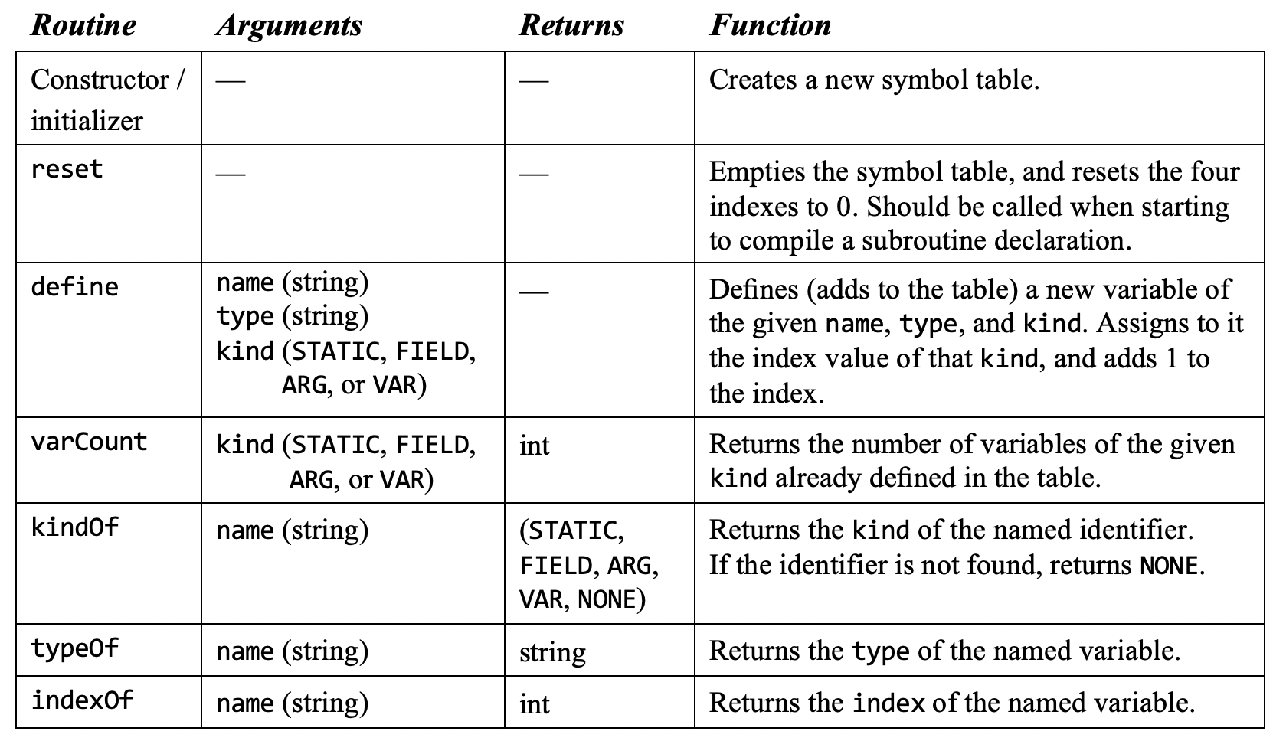
SymbolTable (same as previous slide)

Slide 106
The Jack compiler
JackCompiler
JackTokenizer
CompilationEngine
SymbolTable
VMWriter

Slide 107
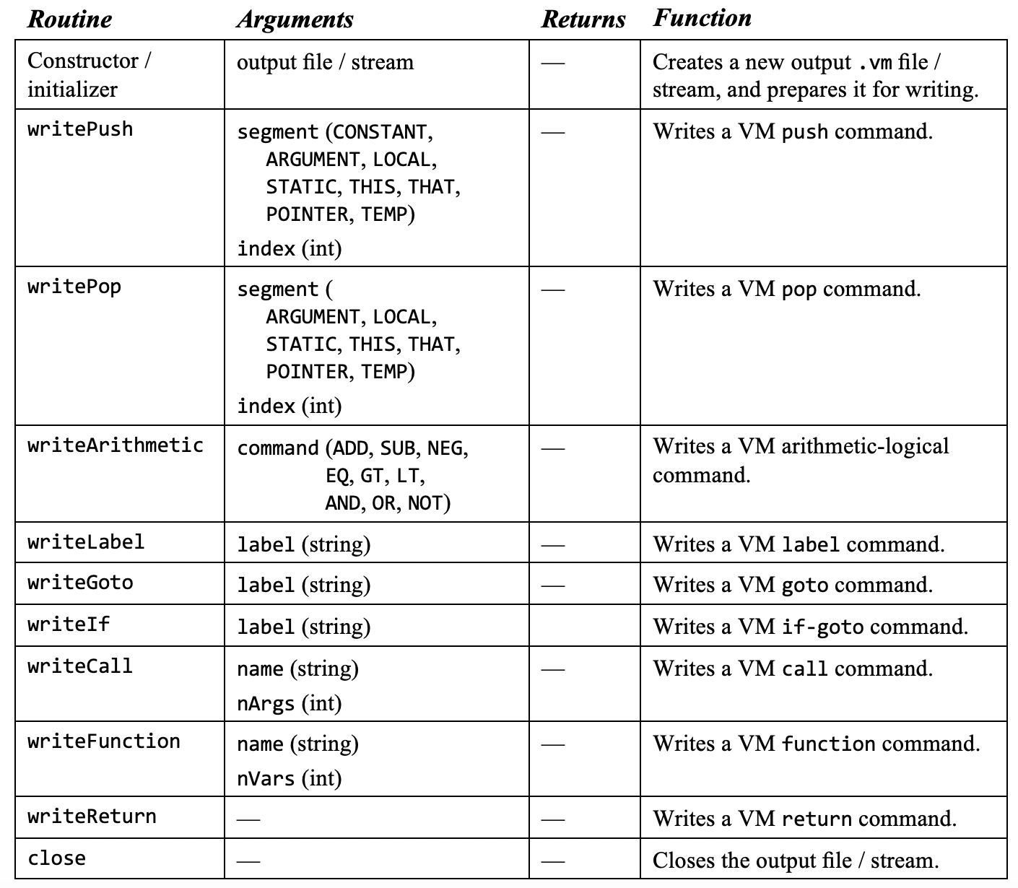
VMWriter
A simple module that writes individual VM commands to the output .vm file.

Slide 108
The Jack compiler
JackCompiler
JackTokenizer
CompilationEngine
SymbolTable
VMWriter

Slide 109
CompilationEngine
The CompilationEngine of the compiler (project 11) and the syntax analyzer (project 10) has the same design and API: a set of compilexxx methods
However, the compilexxx methods generate different outputs. For example:
Output of compileExpression:
<expression>
<term>
<symbol> ( </symbol>
<expression>
<term> <varName> x </varName> </term>
<op> + </op>
<term> <varName> y </varName> </term>
</expression>
<symbol> ) </symbol>
</term>
<op> * </op>
<term> <intConstant> 2 </intConstant> </term>
</expression>
Infix XML code with symbolic variables
project 10
analyzer
source code
(x + y) * 2
project 11
Output of compileExpression:
compiler
push local 0
push local 1
add
push constant 2
Call Math.multiply 2
Postfix VM code
name | type | kind | #
x | int | local | 0
y | int | local | 1

Slide 110
CompilationEngine
Gets its input from a JackTokenizer and writes its output using the VMWriter
Organized as a series of compilexxx routines, xxx being a syntactic element in the Jack grammar:
Each compilexxx routine should read xxx from the input, advance() the input exactly beyond xxx, and emit to the output VM code effecting the semantics of xxx
compilexxx is called only if xxx is the current syntactic element
If xxx is part of an expression and thus has a value, the emitted VM code should compute this value and leave it at the top of the VM’s stack

Slide 111
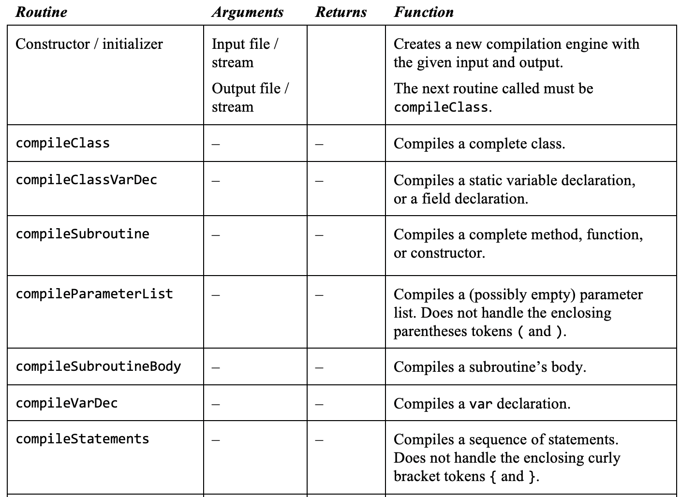
CompilationEngine (same API as in project 10)
Routine
Arguments
Returns
Function

Slide 112
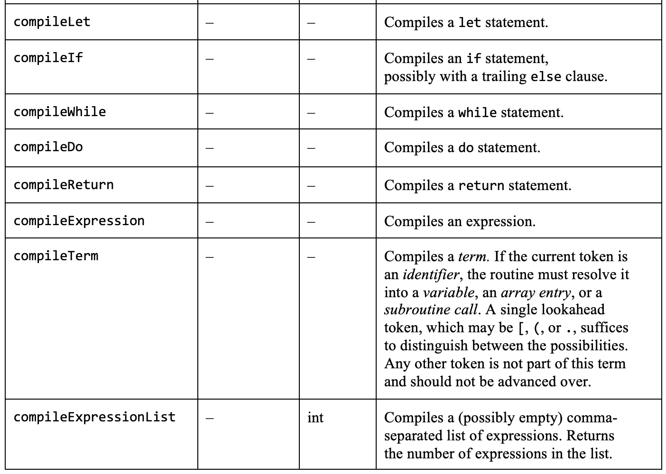
CompilationEngine (same API as in project 10)
Routine
Arguments
Returns
Function

Slide 113
Lecture plan
Compilation
Handling variables
Handling expressions
Handling statements
Handling objects
Handling arrays
Implementation
Standard mapping
Proposed design
Project 11

Slide 114
Compiler development roadmap
project 10
project 10
project 11
Project 11: Extend the syntax analyzer into a full-scale compiler
Stage 0: Syntax analyzer (done)
Stage 1: Symbol table handling
Stage 2: Code generation.
Notes:
Once the output of your syntax analyzer emits XML code properly, it means that you’ve developed a complete executable capability to understand the semantics of Jack programs. At this stage you can make the switch to developing a full-scale compiler and start generating executable VM code instead of static XML code. This can be done by gradually morphing the code of the extended syntax analyze into a full compiler

Slide 115
Symbol table
Output of the syntax analyzer (project 10)
...
<expression>
<term>
<identifier> count </identifier>
</term>
<symbol> < </symbol>
<term>
<intConstant> 100 </intConstant>
</term>
</expression>
...
In the syntax analyzer built in project 10, identifiers were handled by outputting <identifier> identifier </identifier>
Extend the handling of identifiers:
Output the identifier’s category: var, argument, static, field, class, subroutine
If the identifier’s category is var, argument, static, field, output also the running index assigned to this variable in the symbol table
Output whether the identifier is being defined, or being used
Implementation
Implement the SymbolTable API
Extend the syntax analyzer developed in project 10 with the outputs described above (plan and use your own output/tags format)
Test the extended syntax analyzer by running it on the test programs given in project 10.

Slide 116
Compiler development roadmap
project 10
project 10
project 11
Project 11: Extend the syntax analyzer into a full-scale compiler
Stage 0: Syntax analyzer (done)
Stage 1: Symbol table handling
Stage 2: Code generation.

Slide 117
Code generation
Test programs
Seven
ConvertToBin
Square
Average
Pong
ComplexArrays
Unit testing:
Test your evolving compiler on the supplied test programs, in the shown order
Each test program is designed to test some of your compiler’s capabilities.
For each test program:
1. Use your compiler to compile the program folder
2. Inspect the generated code; If there’s a problem, fix your compiler and go to stage 1
3. Load the folder into the VM emulator
4. Run the compiled program, inspect the results
5. If there’s a problem, fix your compiler and go to stage 1.

Slide 118
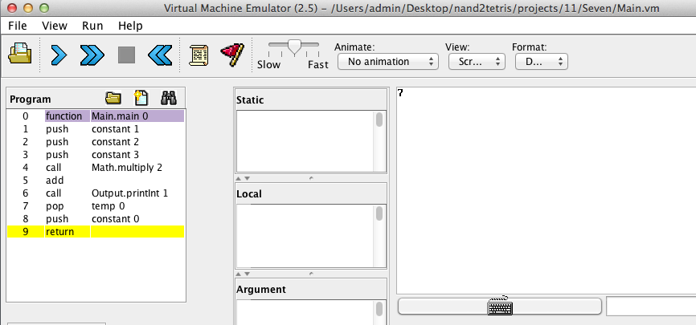
Test program: Seven
projects/11/Seven/Main.jack
projects/11/Seven/Main.vm
/** Computes the value of 1 + (2 * 3)
* and prints the result at the top-left
* corner of the screen. */
class Main {
function void main() {
do Output.printInt(1 + (2 * 3));
return;
}
}
function Main.main 0
push constant 1
push constant 2
push constant 3
call Math.multiply 2
add
call Output.printInt 1
pop temp 0
push constant 0
return
JackCompiler
Tests how your compiler handles:
A simple program
An arithmetic expression involving constants only
A do statement
A return statement

Slide 119
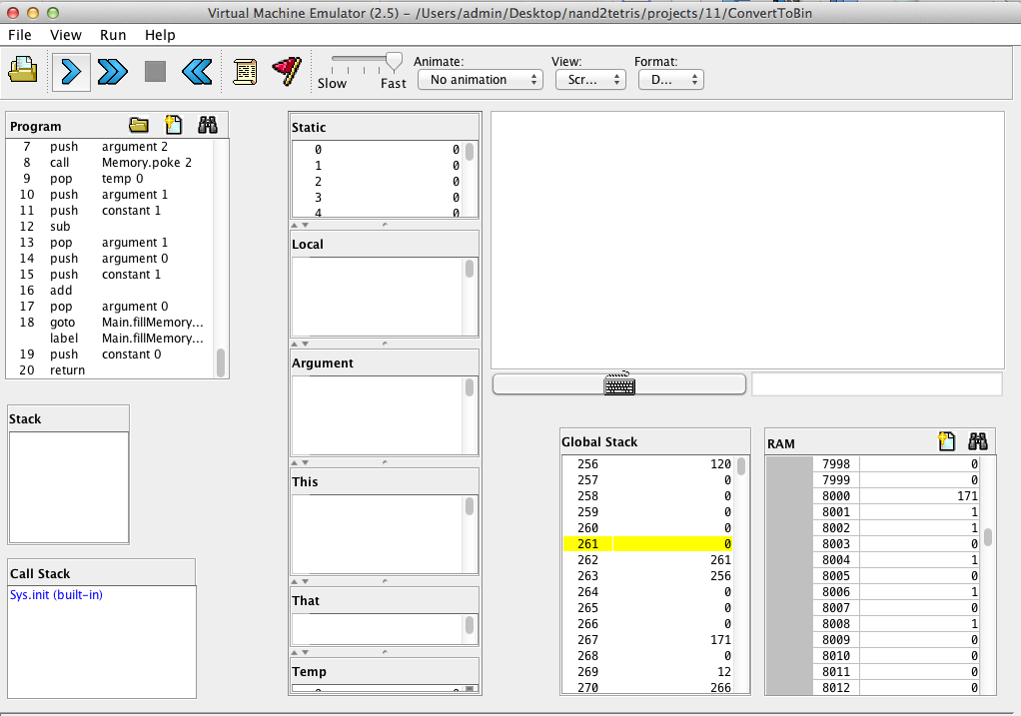
Test program: Decimal-to-binary conversion
Tests how your compiler handles:
Expressions (without arrays or method calls)
Statements: if, while, do, let, return
input: 171 = (10101011)₂
Compiled program: Converts RAM[8000] to binary, and stores the 16 bits in RAM[8001] to RAM[8016]
output

Slide 120
Test program: Decimal-to-binary conversion
class Main {
// Converts RAM[8000] to binary, putting the resulting bits in RAM[8001]..RAM[8016]
function void main() {
var int value;
do Main.fillMemory(8001, 16, -1); // sets RAM[8001]..RAM[8016] to -1
let value = Memory.peek(8000); // gets the input from RAM[8000]
do Main.convert(value); // performs the conversion
return;
}
// Fills 'length' consecutive memory locations with 'value’,
// starting at 'startAddress’.
function void fillMemory(int startAddress, int length, int value) { // code omitted }
// Converts the value to binary, and puts the result in RAM[8001]..RAM[8016] */
function void convert(int value) { // code omitted }
// Some more private functions (omitted)
}
Tests how your compiler handles:
Expressions (without arrays, without method calls)
Statements: if, while, do, let, return

Slide 121
Test program: Decimal-to-binary conversion
stop
rewind
animate mode
binocular
Testing tips:
Use the “binocular” control
Note that the “rewind” control erases the RAM
Note that you cannot enter input into the RAM in “no animation” mode
To see the program’s results (RAM state), click the “stop” control

Slide 122
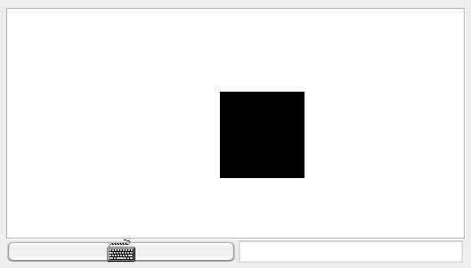
Test program: Square
When the game starts, a black square is displayed at the top left of the screen:
When the game starts, a black square appears at the top left of the screen.
The user can then move and resize the square
Tests how your compiler handles object-oriented features of the Jack language:
Constructors
Methods
Expressions that include method calls.

Slide 123
Test program: Square
projects/11/Square/Square.jack (showing only method signatures)
/** Represents a graphical square object */
class Square {
/** Constructs a new square with a given location and size */
constructor Square new(int Ax, int Ay, int Asize)
/** Disposes this square */
method void dispose()
/** Draws the square on the screen */
method void draw()
/** Erases the square from the screen */
method void erase()
/** Increments the square’s size by 2 pixels */
method void incSize()
/** Decrements the square’s size by 2 pixels */
method void decSize()
/** Moves up by 2 pixels */
method void moveUp()
/** Moves down by 2 pixels */
method void moveDown()
/** Moves left by 2 pixels */
method void moveLeft()
/** Moves right by 2 pixels */
method void moveRight()
}
SquareGame.jack
/** Represents a square game */
class SquareGame {
field Square square; // the square
field int direction; // the square’s direction:
// 0=none, 1=up, 2=down,
// 3=left, 4=right
/** Constructs a new Square Game */
constructor SquareGame new() {
let square = Square.new(0, 0, 30);
let direction = 0;
return this;
}
/** Disposes this game */
method void dispose() {
do square.dispose();
do Memory.deAlloc(this);
return;
}
...
Main.jack
/** Main class of the square game. */
class Main {
/** Initializes and starts a new game */
function void main() {
var SquareGame game;
let game = SquareGame.new();
do game.run();
do game.dispose();
return;
}
}

Slide 124
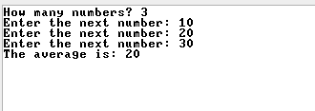
Test program: Average
/** Computes the average of a sequence of integers */
class Main {
function void main() {
var Array a;
var int length;
var int i, sum;
let length = Keyboard.readInt("How many numbers? ");
let a = Array.new(length);
let i = 0;
while (i < length) {
let a[i] = Keyboard.readInt("Enter the next number: ");
let i = i + 1;
}
let i = 0; let sum = 0;
while (i < length) {
let sum = sum + a[i];
let i = i + 1;
}
do Output.printString("The average is: ");
do Output.printInt(sum / length);
do Output.println();
return;
}
}
Tests how your compiler handles:
Arrays
Strings

Slide 125
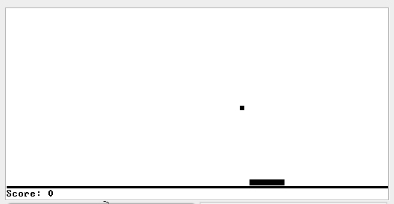
Test program: Pong
pong game
ball
bat
Tests how your compiler handles a complete object-oriented application, including the handling of objects and static variables.

Slide 126
Test program: Pong
projects/11/Pong/Ball.jack
/** A graphic ball, with methods for drawing, erasing
* and moving on the screen. */
class Ball {
// Ball's screen location (in pixels)
field int x, y;
// Distance from last destination
field int lengthx, lengthy;
// Used for straight line movement computation
field int d, straightD, diagonalD;
field boolean invert, positivex, positivey;
// Locations of walls
field int leftWall, rightWall, topWall, bottomWall;
// last wall that the ball was bounced from
field int wall;
/** Constructs a new Ball with an initial ball
* location and wall locations. */
constructor Ball new(int Ax, int Ay, int AleftWall,
int ArightWall, int AtopWall,
int AbottomWall) {}
...
// More Ball methods
}
Bat.jack
/** A graphic paddle with methods for drawing,
* erasing, moving left and right changing width. */
class Bat {
// Screen location
field int x, y;
// Bat’s width and height
field int width, height;
// Bat’s direction of movement
field int direction; // 1 = left, 2 = right
/** Constructs a new bat */
constructor Bat new(int Ax, int Ay,
int Awidth, int Aheight) {
let x = Ax;
let y = Ay;
let width = Awidth;
let height = Aheight;
let direction = 2;
do show();
return this;
}
...
// More Bat methods
}
PongGame.jack
/** Pong game */
class PongGame {
static PongGame instance; // the game
field Bat bat; // the bat
field Ball ball; // the ball
...
/** Creates an instance of a PongGame */
function void newInstance() {
let instance = PongGame.new();
return;
}
...
/** Runs the game. */
method void run() {
var char key;
while (~exit) {
// waits for a key to be pressed.
while ((key = 0) & (~exit)) {
let key = Keyboard.keyPressed();
do bat.move();
do moveBall();
}
if (key = 130) {
do bat.setDirection(1);
}
...
}
}
...
}
Main.jack
/** Main class of the Pong game */
class Main {
/** Initializes a Pong game and
starts running it. */
function void main() {
var PongGame game;
do PongGame.newInstance();
let game = PongGame.getInstance();
do game.run();
do game.dispose();
return;
}
}

Slide 127
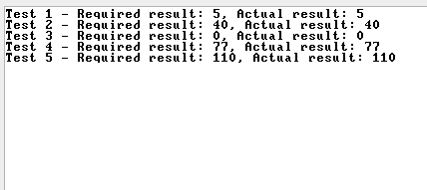
Test program: ComplexArrays
projects/11/ComlpexArrays/Main.jack
class Main {
function void main() {
var Array a, b, c;
let a = Array.new(10);
let b = Array.new(5);
...
// Fills the arrays with some data (omitted)
...
// Manipulates the arrays using some complex index expressions
let a[b[a[3]]] = a[a[5]] * b[7 - a[3] - Main.double(2) + 1];
...
// Prints the expected and the actual values of a[b[a[3]]]
...
}
// A trivial function that tests how the compiler handles a subroutine
// call within an expression that evaluates to an array index
function int double(int a) {
return a * 2;
}
// Creates a two dimensional array
function void fill(Array a, int size) {
while (size > 0) {
let size = size - 1;
let a[size] = Array.new(3);
}
return;
}
}
Tests how your compiler handles array manipulations using index expressions that include complex array references

Slide 128
Lecture plan
Compilation
Handling variables
Handling expressions
Handling statements
Handling objects
Handling arrays
Implementation
Standard mapping
Proposed design
Project 11

Slide 129
Chapter 11
Compiler II: Code Generation

